Slide 1
Traumatic Brain Injury
Sepehr Sani, MD
Department of Neurosurgery
Rush University Medical Center
September 16, 2016

Slide 2
Disclosures
None

Slide 3
Objectives
Define the various classifications of head injuries
Discuss the differences between
Traumatic Brain injury (TBI)
Closed Head Injury (CHI)
Concussion
Post Concussion Syndrome
Describe the diagnosis and management recommendations for various head injuries
Discuss the prognosis of the head injured patient

Slide 4
Traumatic Brain Injury (TBI)
Requires traumatic contact with the skull
Penetrating Injury
Violation of skin, skull, and dura with damage to the brain matter
Closed Head Injury (CHI)
e.g. Non-Penetrating Injuries
Any trauma that does NOT result in violation of skull or dura
Concussion
Requires an alteration in consciousness
Requires LACK of any anatomical damage
“MRI negative”
Contusion
Intracerebral hemorrhage
Cerebral edema
Hematomas (SDH, EDH)
“MRI/CT positive”
Diffuse Axonal Injury
“MRI unique”

Slide 5
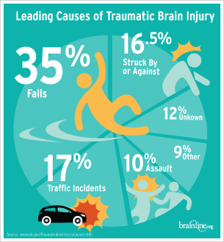
Traumatic Brain Injury (TBI)
Brain damage resulting from external forces, as a consequence of direct impact, rapid acceleration or deceleration, a penetrating object or blast waves from an explosion. The nature, intensity, direction and duration of these forces determine the pattern and extent of damage.
Accounts for 35% of all brain damage deaths
MD, H. R. W. Youmans Neurological Surgery,6e. (Saunders, 2011)

Slide 6
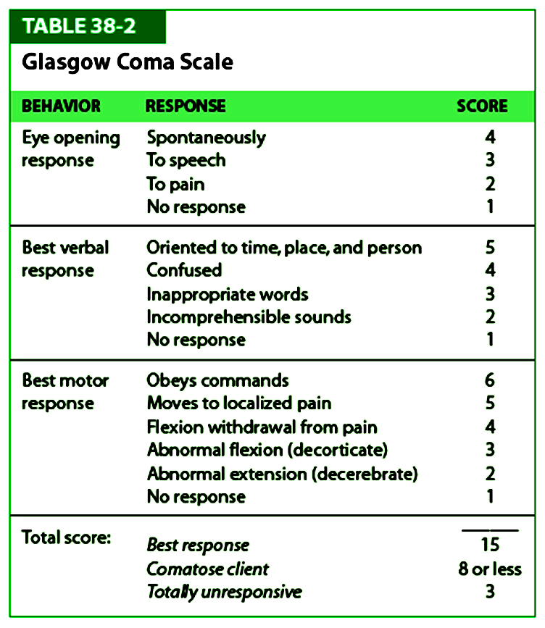
Clinical Severity
TBI can be classified based on clinical presentation
GCS = Glasgow coma scale, PTA = post traumatic amnesia, LOC = loss of consciousness
Department of Defense and Department of Veterans Affairs (2008). "Traumatic Brain Injury Task Force".

Slide 7
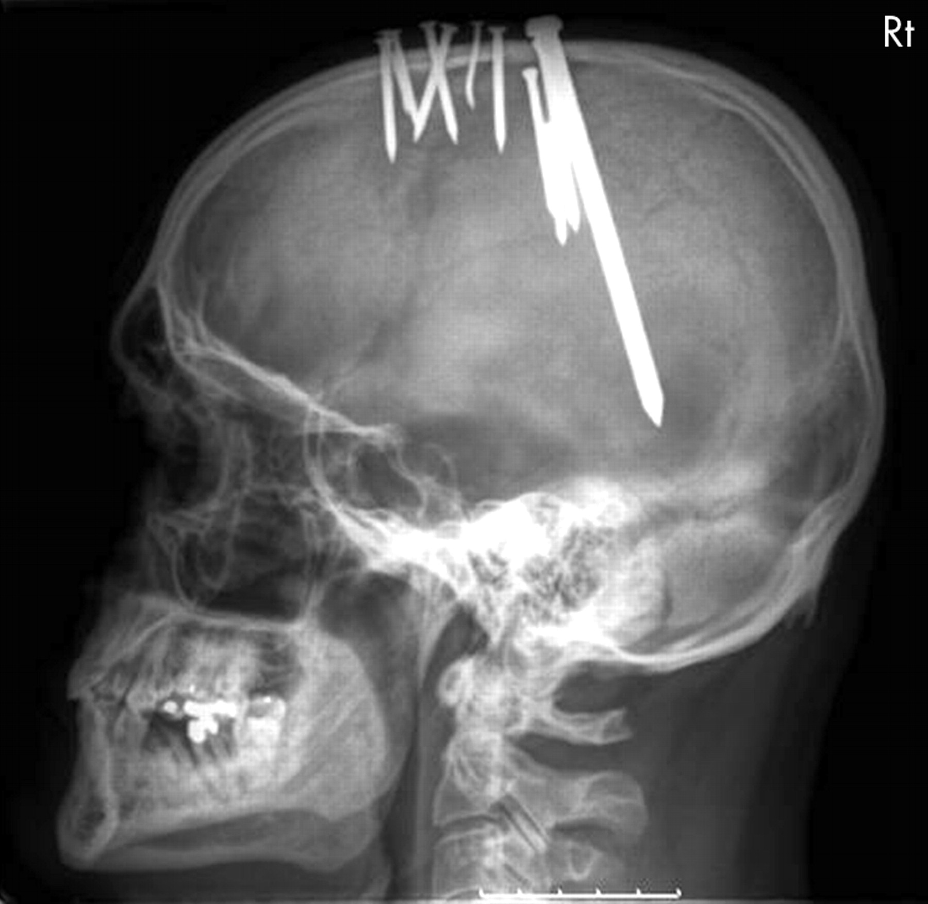
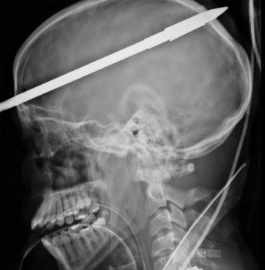
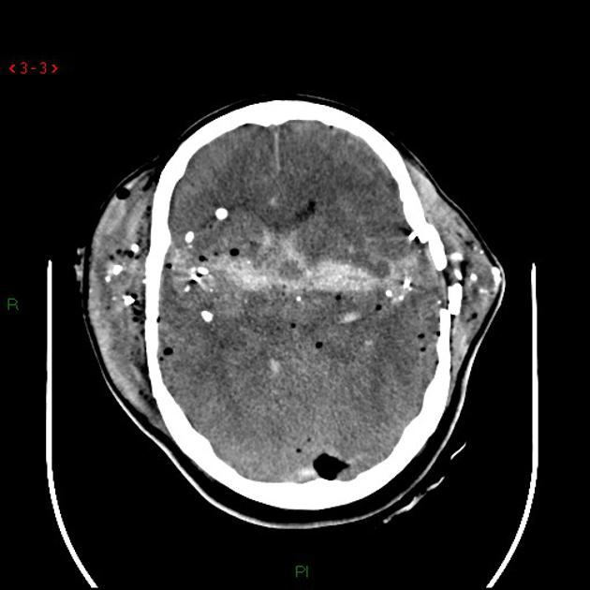
Penetrating Injuries

Slide 8
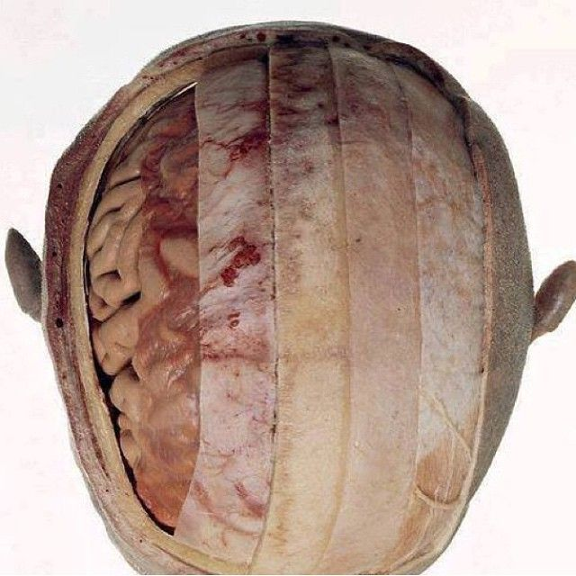
Closed Head Injury
A mechanistic classification of TBI in which the skull and dura mater remain intact.
Can be high or low impact mechanism of injury leading to mild, moderate or severe TBI

Slide 9
CHI – Contusion & ICH
Often as a result of fall or altercation
Contusion - Bruising of the brain
ICH – Bleeding in the brain
Most common location frontal and temporal lobes
Long-term sequela:
Personality
Judgement
Impulse control
Location specific

Slide 10
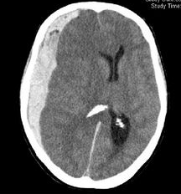
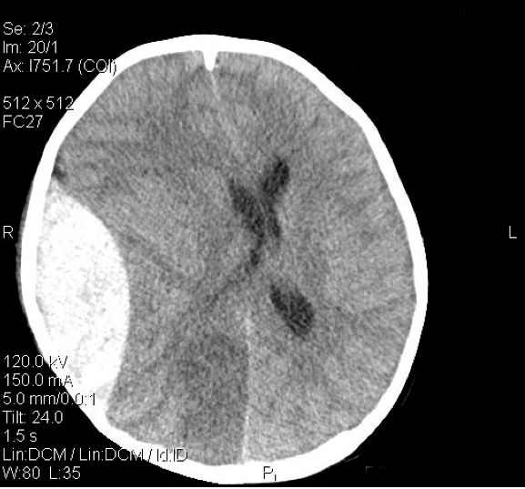
SDH / EDH
SDH
Subdural hematoma
Tear in bridging vein
Prognosis guarded
EDH
Epidural hematoma
Tear of MMA
High mortality
If you survive prognosis “ok”

Slide 11
Diffuse Axonal Injury (DAI)
A primary lesion secondary to traumatic rotational acceleration/deceleration injury
A common cause of persistent vegetative state and morbidity in TBI patients
Diagnosed clinically when when LOC > 6 hours in absence of intracranial mass lesion or ischemia on CT
Wasserman J. and Koenigsberg R.A. (2007).

Slide 12
DAI Severity Scale
Bay E, McLean SA: J Neurosci Nurs 2007 Feb;39:43–51

Slide 13
Concussion
A form of mild TBI or CHI
There is alteration of consciousness even if momentary immediately following the trauma
Often with post-traumatic amnesia (PTA)
Initial diagnosis made in ED
Over & Under diagnosed
NO structural damage
Greenberg MS: Handbook of Neurosurgery. 7 edition Tampa, Fla, Thieme, 2010.

Slide 14
Concussion Signs/Symptoms
MD, H. R. W. Youmans Neurological Surgery,6e. (Saunders, 2011)

Slide 15
Acute Concussion Evaluation

Slide 16
Concussion Diagnosis
Diagnosis is subjective and based on:
Mechanism of injury
LOC and duration
Amnesia and duration
Signs
Symptoms

Slide 17
Concussion Grading Scales
Cantu RC. J Athl Train 2001;36:244–248.

Slide 18
Treatment of Acute Concussion
Grade I
CT scan usually not indicated
May be managed with observation at home if meet the following criteria
Initial GCS > 14
Presently neurologically intact
A responsible adult is able to observe patient
Patient has reasonable access to return to ED
No suspicion of “complicating” circumstances (e.g. domestic or child abuse)
Resolves in 24-48 hours
Grade II
Non-contrast head CT indicated
If head CT negative, patient may be observed at home if meets criteria for Grade I
Usually resolves within 24-48 hours
Grade III
STAT non-contrast head CT
If head CT negative, patient observed for extended duration in ED or admitted for 24hr observation
Re-evaluation by physician in 24 to 48 hours
If no progression of symptoms, complete resolution is seen within 7 days in majority of cases

Slide 19
Concussion Prognosis
The great majority of patients recover fully within 7 days
If multiple symptoms persist greater than 7 days, the patient is diagnosed with post-concussion syndrome (PCS)
Various studies site 5-30% of concussion patients developing PCS
Interestingly, the likelihood and severity of PCS is irrelevant of initial concussion severity
NB: Difference between single and multiple concussions

Slide 20
Concussion Prognosis
Best predictor of outcomes after TBI is length of PTA
The longer the duration of PTA, the worse outcomes generally are.
Clinically, resolution of PTA occurs when patients are able to incorporate daily events into working memory.
Patients with PTA of less than 24 hours generally have a quick and full recovery with few exceptions, and patients with PTA of more than 4 weeks generally have permanent deficits.
Severe disability is unlikely with PTA of less than 2 months, and good recovery is unlikely when PTA is more than 3 months.
MD, H. R. W. Youmans Neurological Surgery,6e. (Saunders, 2011)

Slide 21
Post Concussion Syndrome (PCS)
Persistence of three or more symptoms of concussion after 7 days from original injury
Most common
Headache
Fatigue
Vertigo
Risk factors
Age > 40
Female
Pre-existing psychiatric diagnosis (depression, anxiety)
Psychosocial, secondary gain

Slide 22
Post Concussion Syndrome (PCS)
Cognitive symptoms
Impaired concentration, short term memory and/or judgement
Can be objectively tested
Somatic symptoms
Dizziness, blurred vision, balance difficulties, tinnitus
Can be objectively tested
Psychosocial symptoms
Emotional lability, depression, personality changes, loss of libido, early fatigue
Subjective, cannot be tested
Greenberg MS: Handbook of Neurosurgery. 7 edition Tampa, Fla, Thieme, 2010.

Slide 23
PCS Treatment and Prognosis
Treatment is symptom related as there is no catch all treatment for PCS. However:
EARLY neuropsychological assessment with testing is essential
MRI imaging to evaluate for organic cause
EARLY specialist referral (e.g. vestibular, cognitive, and physical rehabilitation for each symptom) is key
Prognosis remains excellent – for “single” traumatic event (excludes sports with repeat injury)
Full recovery within 3 months, sometimes as long as one year
If symptoms persist or change, consideration should be given to alternative diagnosis

Slide 24
Long term Sequelae of Repeated Concussions
Chronic traumatic encephalopathy (CTE)
Progressive degenerative disease found in those who have sustained multiple repeated blows to the head
Early stage symptoms include deterioration in attention as well as disorientation, dizziness, and headaches.
Further disabilities appear with progressive deterioration, including memory loss, social instability, erratic behavior, and poor judgment.
Late stages include progressive dementia, slowing of movement, impeded speech, tremors, suicidality
Greenberg MS: Handbook of Neurosurgery. 7 edition Tampa, Fla, Thieme, 2010.

Slide 25
Thank You!

Slide 26
References
Bay E, McLean SA: Mild traumatic brain injury: an update for advanced practice nurses. J Neurosci Nurs 2007 Feb;39:43–51.
Cantu RC: Posttraumatic Retrograde and Anterograde Amnesia: Pathophysiology and Implications in Grading and Safe Return to Play. J Athl Train 2001;36:244–248.
Corsellis JA, Bruton CJ, Freeman-Browne D: The aftermath of boxing. Psychol Med 1973 Aug;3:270–303.
Greenberg MS: Handbook of Neurosurgery. 7 edition Tampa, Fla, Thieme, 2010.
Marshall LF, Marshall SB, Klauber MR, Van Berkum Clark M, Eisenberg H, Jane JA, et al.: The diagnosis of head injury requires a classification based on computed axial tomography. J Neurotrauma 1992 Mar;9 Suppl 1:S287–292.
MD, H. R. W. Youmans Neurological Surgery, 4-Volume Set: Expert Consult - Online and Print, 6e. (Saunders, 2011).
Park SJ, Hur JW, Kwon KY, Rhee JJ, Lee JW, Lee HK: Time to Recover Consciousness in Patients with Diffuse Axonal Injury : Assessment with Reference to Magnetic Resonance Grading. J Korean Neurosurg Soc 2009 Sep;46:205–209.
Diffuse Axonal Injury Imaging: Overview, Radiography, Computed Tomography Available from: http://emedicine.medscape.com/article/339912-overview

