Slide 1
Spine Injuries in the WC patient, why don’t they get better??
Pain & Spine Institute
Udit Patel, DO and Samir Sharma, MD

Slide 2
Outline
Introduction
Basic Sciences / Evaluation of the pain patient
Overutilization, inappropriate/lack of care, proper documentation
Case Studies
Statistics
Guidelines and Standard of Care (i.e. No series of 3 ESI, proper training)
Best practices / Goals (realistic expectations for the patient)

Slide 3
Pain & Spine Institute
Introduction
Board Certified and Fellowship trained (ask!)
In practice since 2007
Experienced in the injured patient via multiple angles
www.pain-spine.com
Joliet / Frankfort / Chicago

Slide 4
Basic Sciences
Anatomy
Common Pain Conditions
Evaluation of the patient

Slide 5
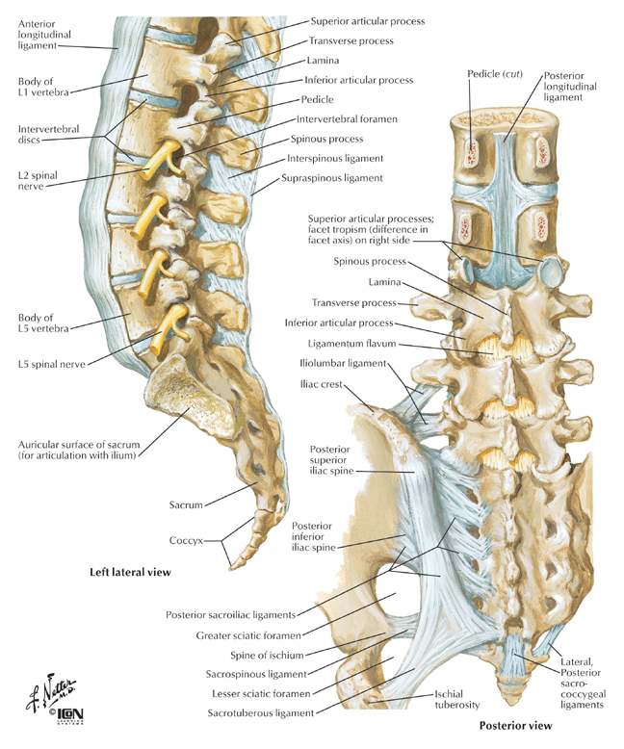
Anatomy
Numerous areas that can generate pain
Diagnosis is key
Proper history, PE, and test will navigate tx
Controlled diagnostic blocks

Slide 6
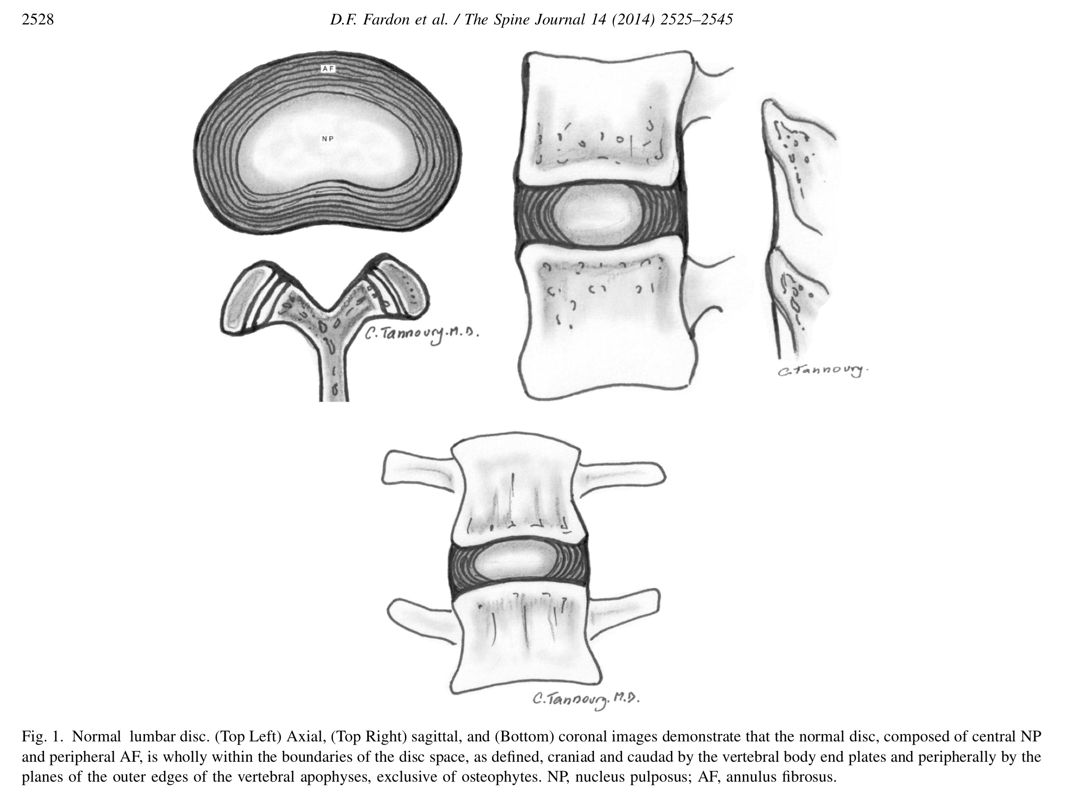
Normal Disc

Slide 7
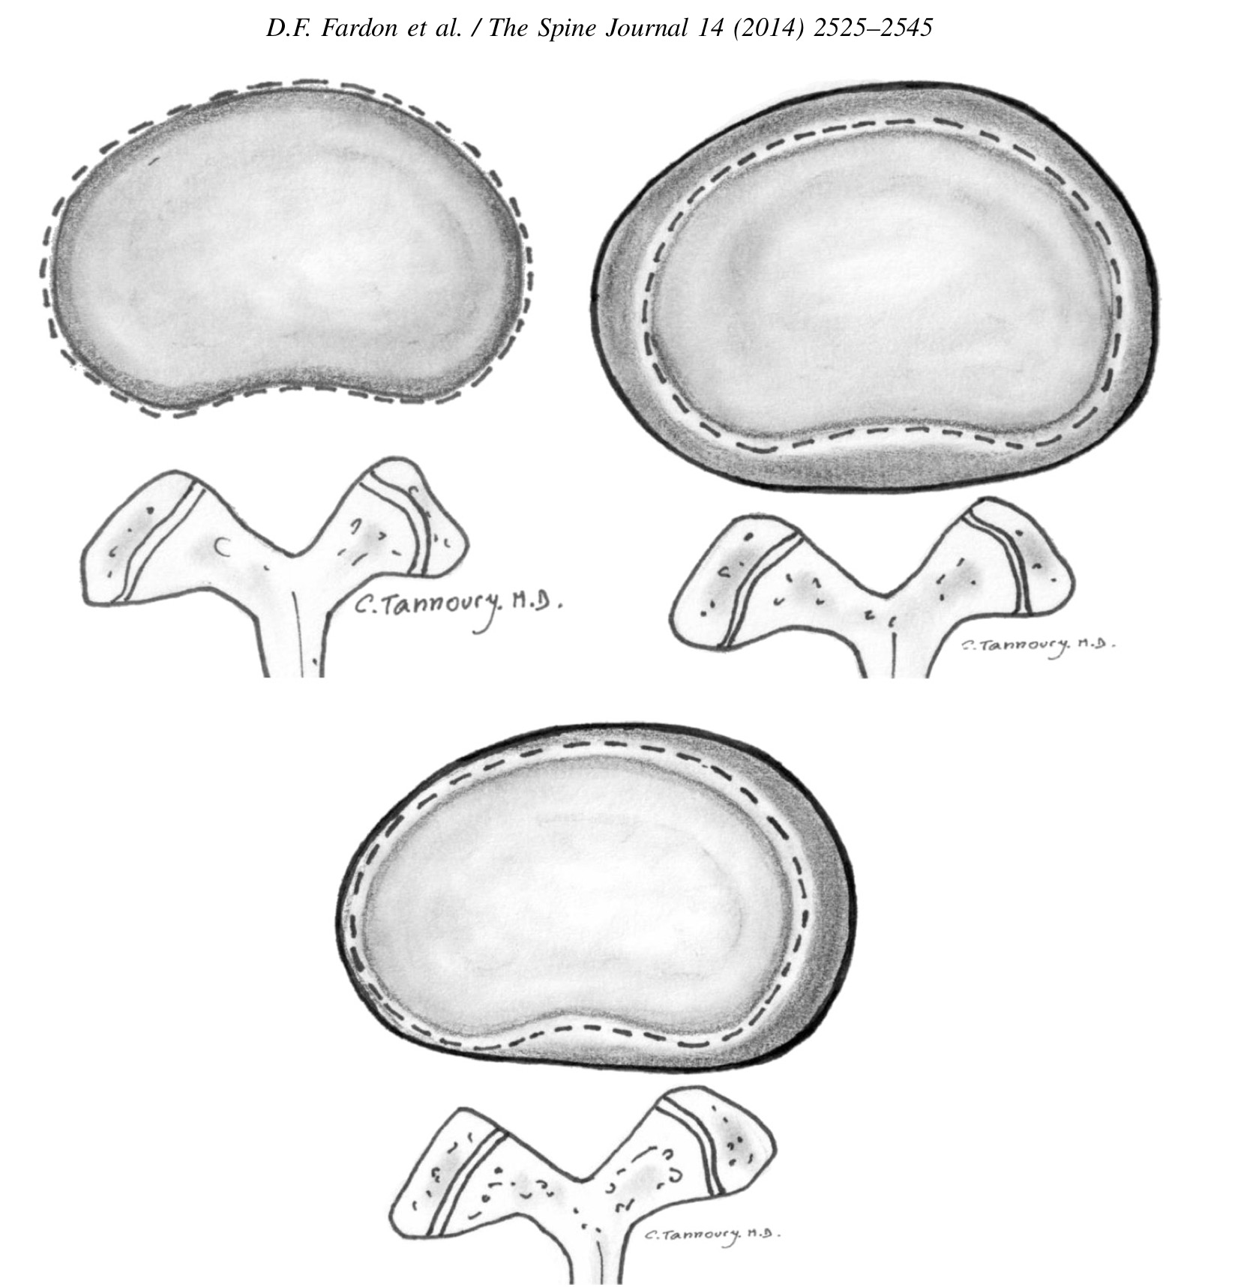
Bulging
Presence of disc tissue expecting beyond the edges of the ring apophyses, throughout the circumference of the disc
NOT considered a form of herniation

Slide 8
Disc Nomenclature
Degeneration: Broad term
Annular Fissure: (does not = injury) Separation of the annular fibers from each other or the bone
Degeneration: Desiccation, fibrosis, narrowing of the disc space, diffuse bulging of the annulus beyond the disc space, fissuring mucinous degeneration of the annulus, intradiscal gas, opsteophytes of the vetrebral apophyses, defects, inflammatory changes, and sclerosis of the end plates.
Herniation: Broadly defined as a localized or focal displacement of disc material beyond the limits of the intervertebral disc space. Classified as protrusion or extrusion

Slide 9
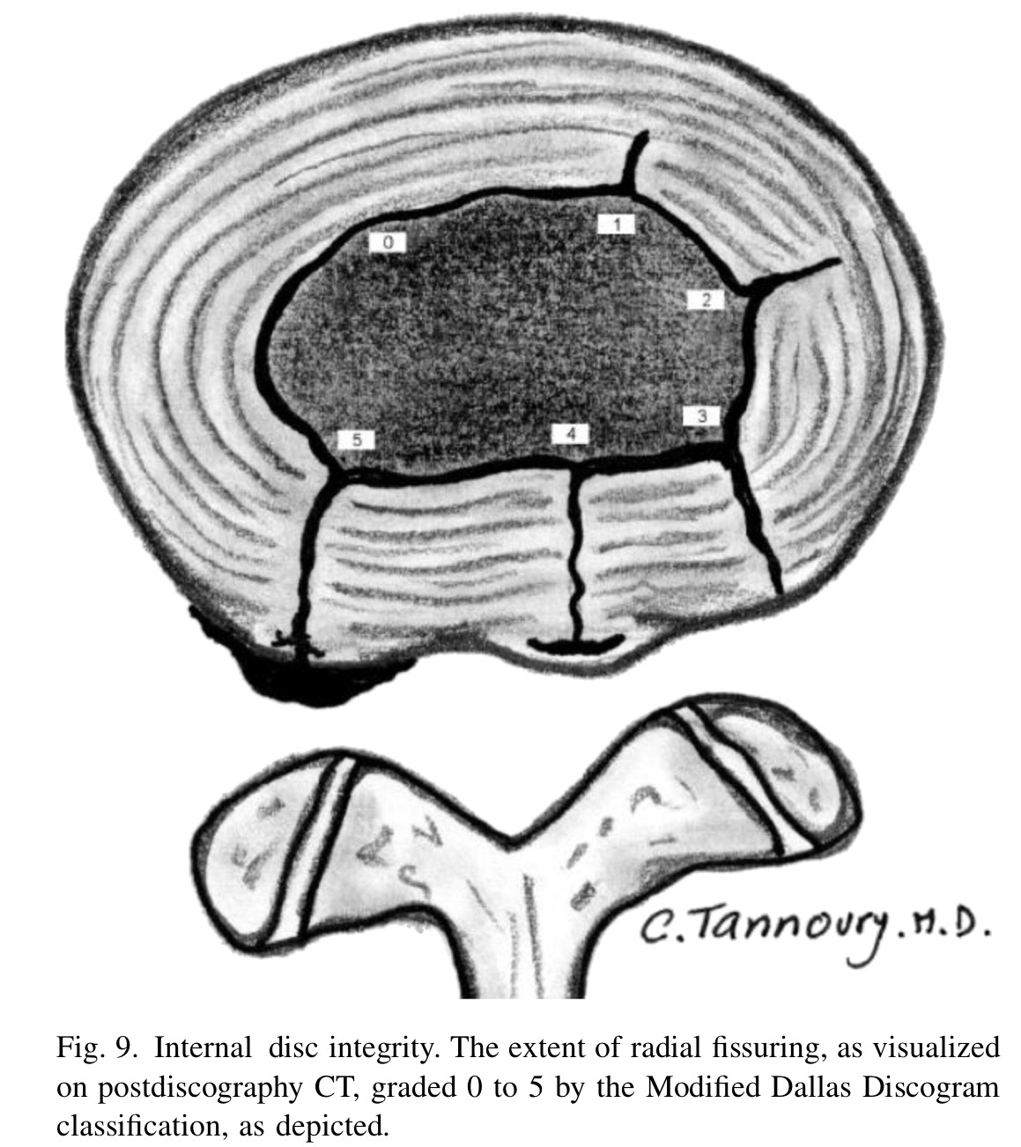
Annular Fissure
Dallas Classification
Outer ½ - ⅓ is innervated

Slide 10
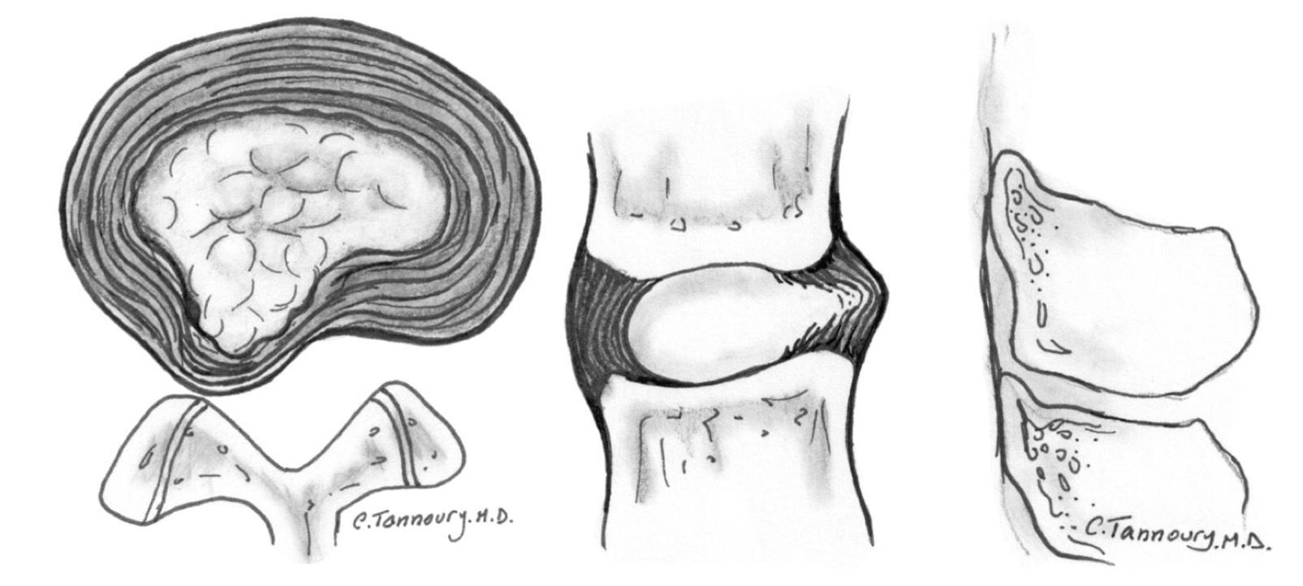
Protrusion
Disc material is displaced beyond the disc space and is continuous with the disc material within the disc space

Slide 11
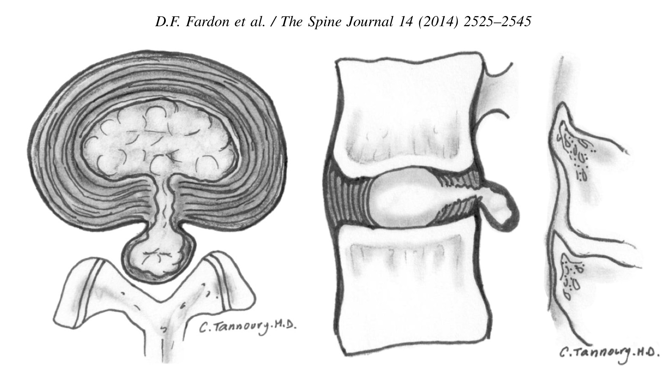
Extrusion

Slide 12
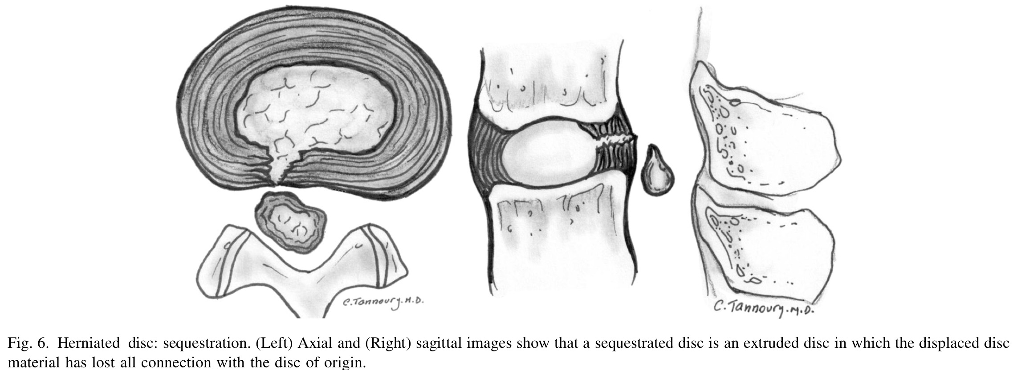
Extrusion: Sequestration
Lost continuity completely with the parent disc.
May also have extrusion with migration if displacement of disc material away from the site of extrusion

Slide 13
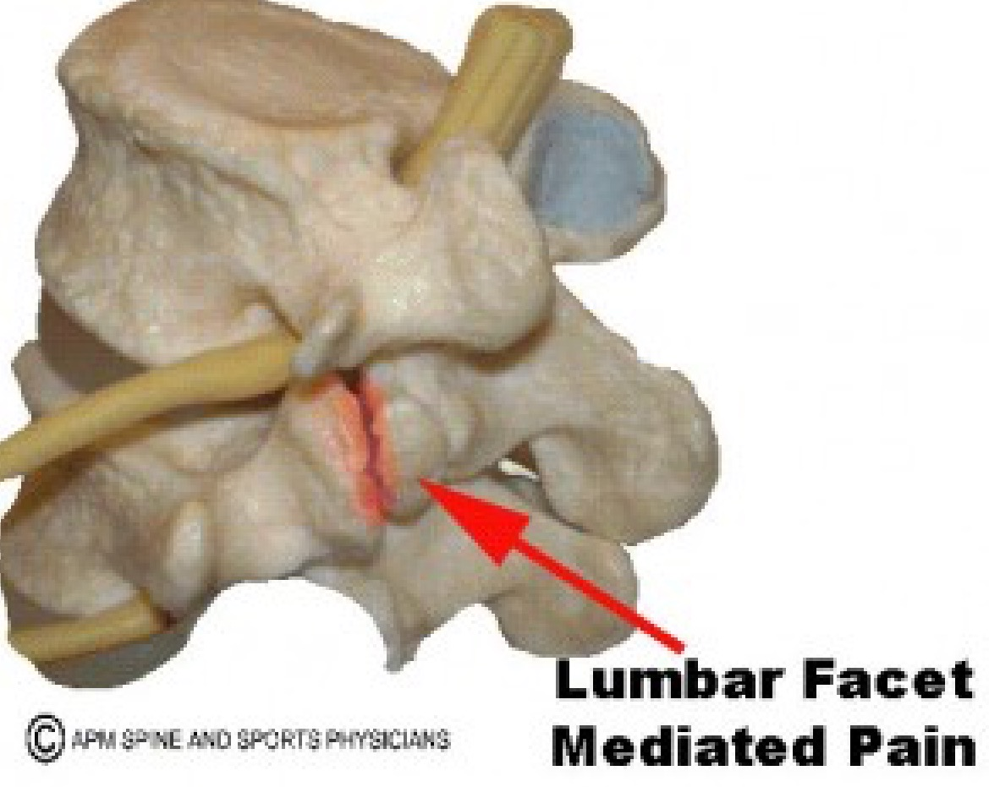
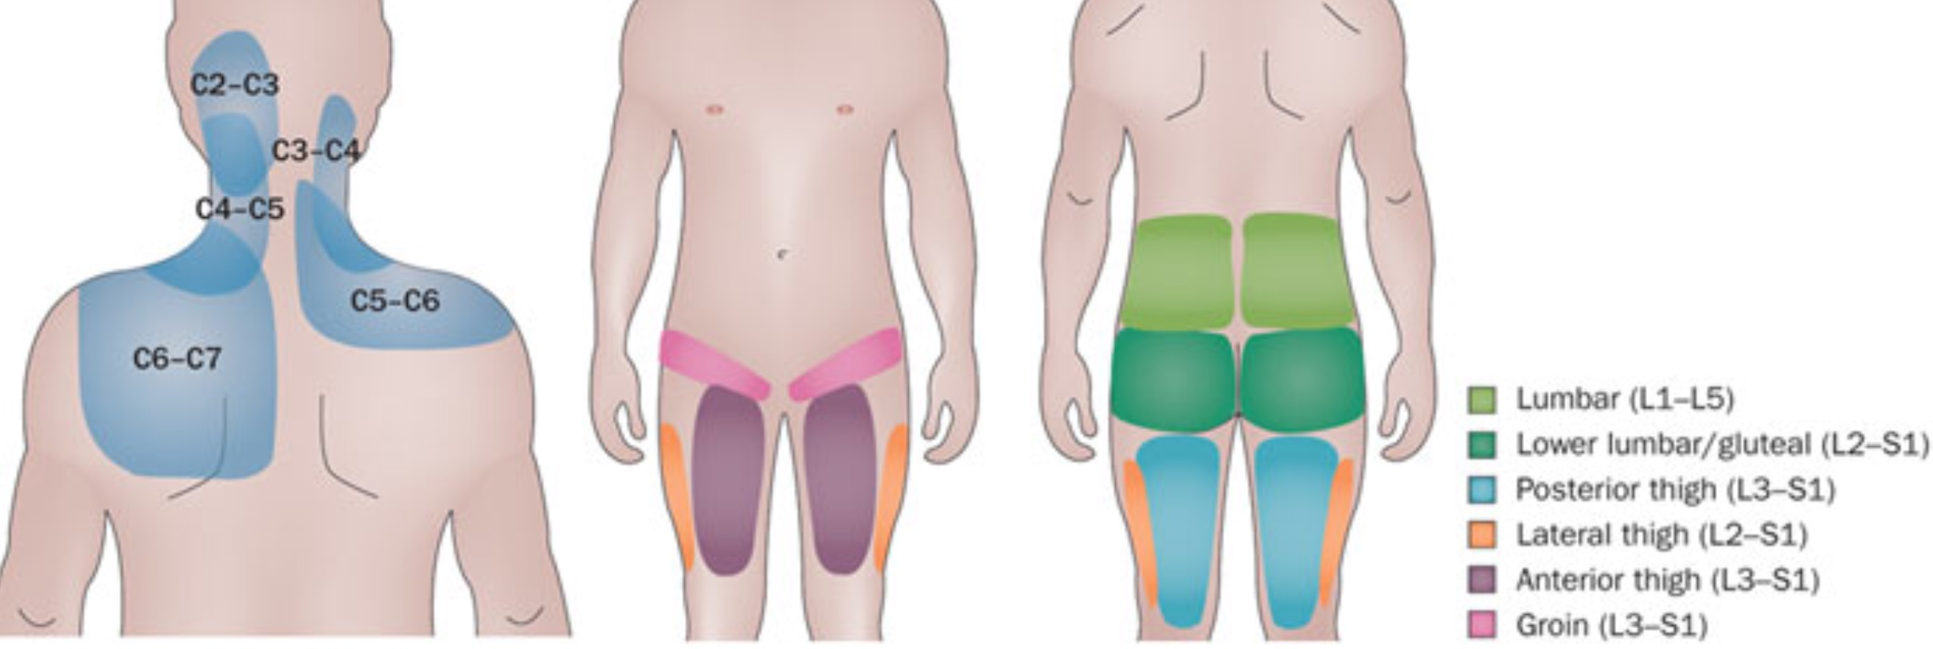
Facet joints

Slide 14
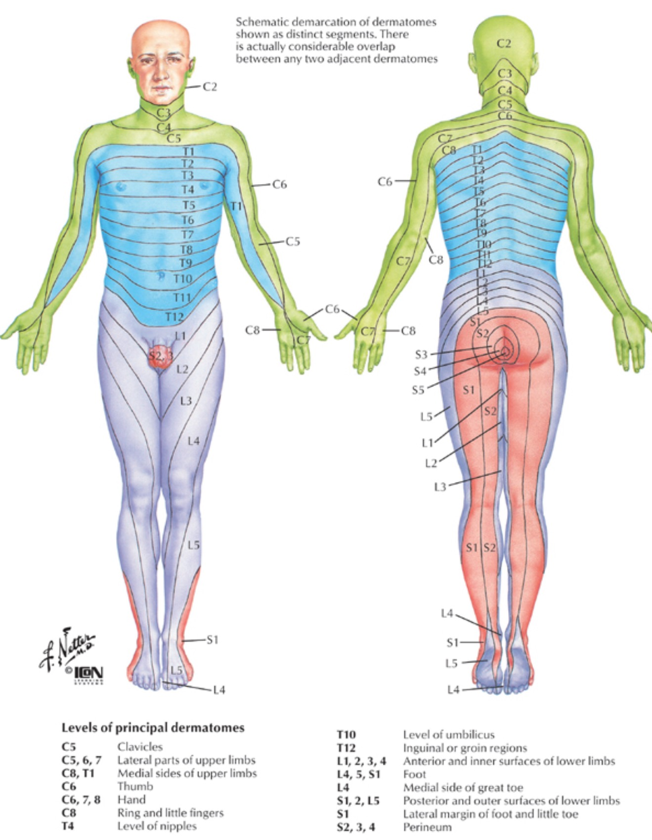
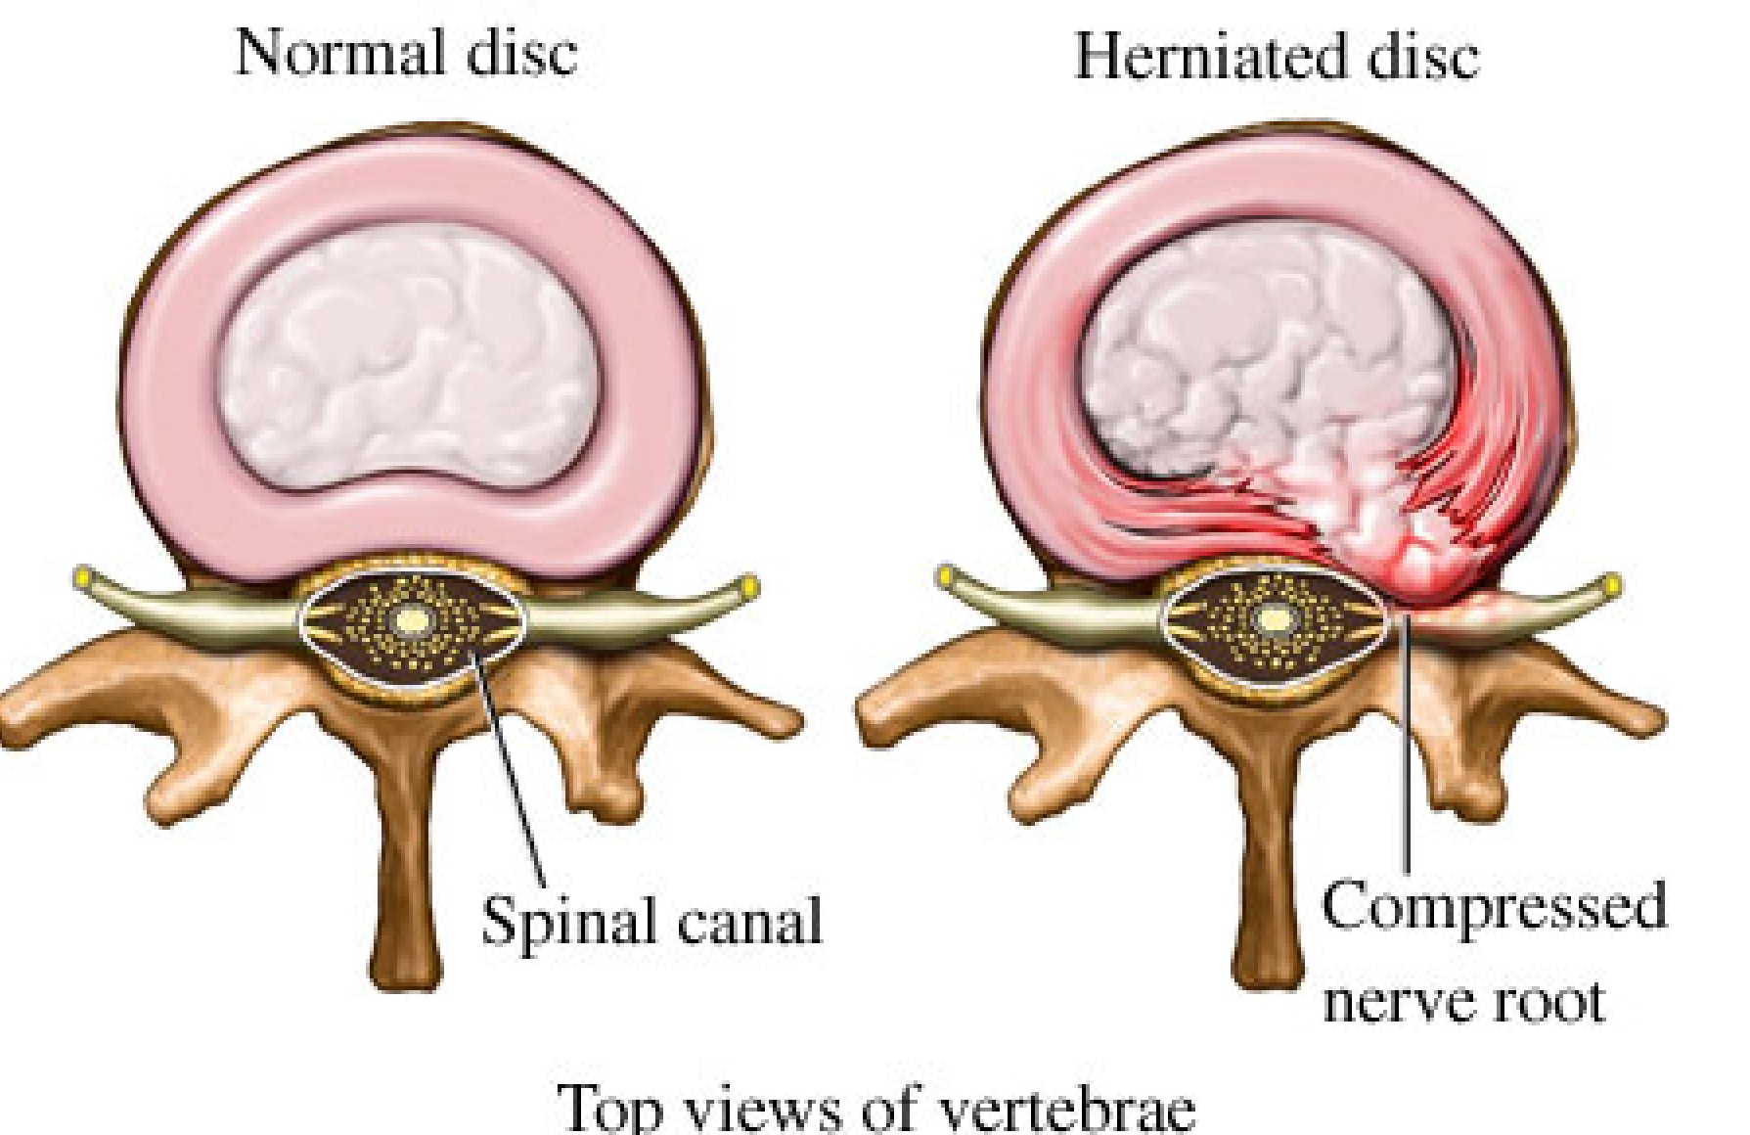
Spinal Nerve

Slide 15
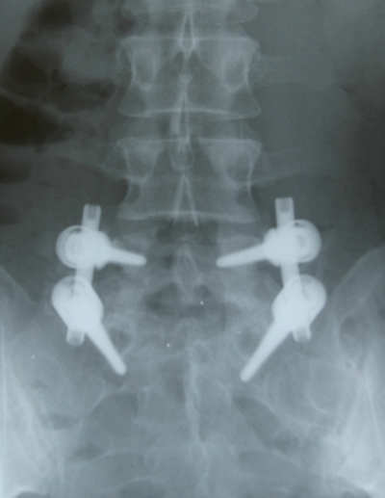
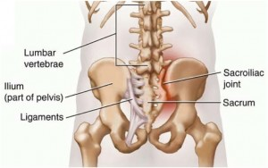
Sacro-Iliac Joints

Slide 16
Evaluation of the Patient
History
Same in Acute vs Chronic
Mechanism of Injury
Treatments to date (and what worked)
Location and Aggravating factors
Physical Examination
Differs in Acute vs Chronic
A-Delta / C-fibers

Slide 17
Problems with Pain Management
Black hole of cost
Not giving proper goals to the patient
Need to provide a diagnosis / generator of the pain
No endpoint
Working in conjunction with other health care providers

Slide 18
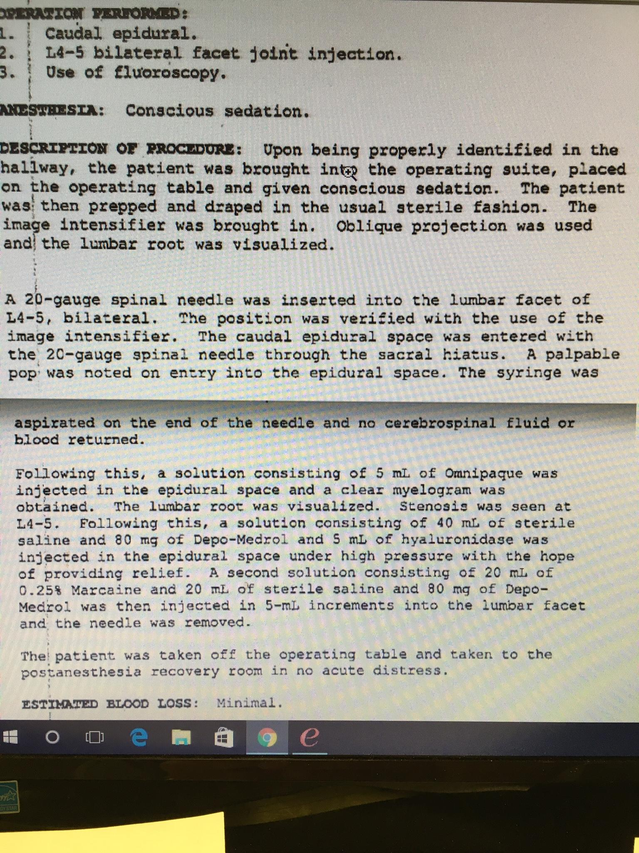
Overutilization/ Case Study
Let’s deconstruct this procedure report:
2 procedures at the same time
Volume and dose of medications
Not done by pain physician

Slide 19
Statistics
Back Pain:
-Singular occurrence 15-30% general population
-Lifetime occurrence 60-80%
-Peaks between 39-65 yrs of age
-Females > Males in all age groups
-Higher prevalence in high income economies

Slide 20
Occupational Risk Factors
Spine 4/2015 Aline Ramond-Roquin, MD et al;
Biomechanical Factors:
-frequent bending (>2hr);
-high physical weight demand >50lbs occasional; 20-50lbs >2 hrs/day
-Driving Industrial vehicles (tractors/forklifts w/ whole body vibrations) occasional
-Non-Industrial vehicles > 4hrs

Slide 21
Occupational Risk Factors
Organizational Factors:
-Working more hrs then planned
-Multiple tasks
-Variable pay
-Working with colleagues with fixed contracts

Slide 22
Occupational Risk Factors
Psycho-social Factors:
-Low job decision authority
-Low skill discretion
-Low support co-workers/supervisor
Individual Factors:
-Age; Inc height; Obesity

Slide 23
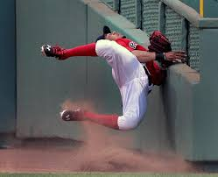
Strain/Sprain Injuries
Strain:
Muscle/tendon Injury
Sprain:
Ligamentous injury of a Joint
--#1 Overall complaint--
--Implied NOLBP in WC pts--

Slide 24
??Non-Organic LBP
Spine 1980 Waddell et al.;
-Tenderness Test: non-anatomic
-Stimulation Test: rotation/axial loading
-Distraction Test: SLR
-Regional Disturbances: sensory/motor vs normal neuro-anatomy
-Over-reaction: demeanor/reaction to testing
DOES NOT exclude organic cause or constitute Malingering

Slide 25
??Non-Organic LBP
Clinical J of Pain; 2004 Fishbain et al.
“There was little evidence for the claims of an association of Waddell’s signs and secondary gain/malingering. The preponderance of evidence points to the opposite. No Association.”
Am J Phys Rehab/Med 2010
Waddell and colleagues stressed did not indicate malingering but rather psychosocial issues that mitigate against successfully treating low back pain by lumbar discectomy.

Slide 26
Risk Factors for NOLBP in WC Patients
Spine 7/2014 Rohrlich et al.;
Study Design:
1 Spine Surgeon
University Medical Center
127 patients over 2 yrs
NOLBP defined as 4+ Waddell’s or 3+ Waddell’s + Inconsistent behavior

Slide 27
Risk Factors for NOLBP in WC Patients
RESULTS: 3+ approx 95% sensitivity of Non-Organic Pain
-Initial visit with Chiropractor
-Slip&Fall; lifting patient
-Occupation as a Health Care Employee
-Time off work> 3 months; work status>Disabled
-Previous WC claim
-Multiple body parts

Slide 28
Risk Factors for NOLBP in WC Patients
CONCLUSION:
-Increased health care costs with unnecessary spine interventional/surgical referrals;
-Poor surgical outcomes
-Higher disability rates

Slide 29
Surgical Statistics in WC Patients
Lumbar Discectomy:
-20-40% have recurrence of pain
-5-15% recurrent disc HNP
-13% never RTW
Spine 2014 Anderson et al.;

Slide 30
Surgical Statistics in WC Patients
Spine 2014 Anderson et al.;
Ohio WC; 1993-2010; 2200pts;
RTW defined as w/in 2yrs of fusion; missed <4 months subsequent yr
Lumbar Fusions:
-39.4% for spondylolisthesis
-31.4 for axial LBP

Slide 31
Surgical Statistics in WC Patients
Spine 10/2015 Faour et al.;
Cervical Fusions:
Ohio WC; 1993-2011; 2200pts;
RTW defined as employment 1yr after surgery
-53.1% for radiculopathy
-39.8% for DDD/axial neck pain

Slide 32
Surgical Statistics in WC Patients
Spine 10/2015 Faour et al.;
Pre-Operative opioid use > 3 months versus less than 3 months
RTW in 1st year post-ACDF:
23.5% vs 45.0%
Sustained work 3 years after surgery
34.5% vs 55.8%

Slide 33
Why the Low Success Rates vs General Population
Spine 9/2012 Block et al.;
129 non-WC vs 36 WC;
Pre-surgical screen with MMPI & Psychologist prior to spine surgery
Results:
College Education 8.3% (WC) vs 35.7% (nWC)
Increased Behavior Restricting Fear
Increased Aggression/Aberrant experiences
Increased Entitlement

Slide 34
Why the Low Success Rates vs General Population
Conclusion:
-Compromised surgical outcomes with behavior/personality factors that are more prominent in WC population;
-Lower educational and personality profiles (w/respect to emotions; self image; pain) result in increased complaints when compared to nWC patients;
Recommendations:
Consider MMPI/neuro-psych screen prior to larger procedures/surgery (ie SCS/Spine)

Slide 35
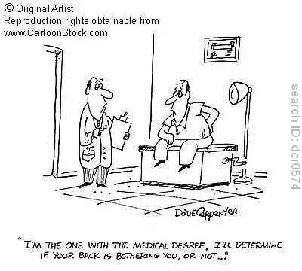
Standard of Care/Best Practice Guidelines

Slide 36
Standard of Care/Best Practice Guidelines
Patient Expectations on NPV
Patients should understand goals as soon as possible, ie work status
Off Work consideration in pts with objective evidence of neuro deficits
Sedentary to Light PDL consistent with normal ADLs
Minimize cookie cutter ancillary use:
No goodie bags of medications; topical creams;
Urine Toxicology (not testing illicits)
Bracing

Slide 37
Standard of Care/Best Practice Guidelines
Physical/Chiropractic Therapy:
Muscle/Ligamentous strain injuries: MMI after 4-6 wks therapy
ODG 8-12 visits over 8 wks for radiculopathy

Slide 38
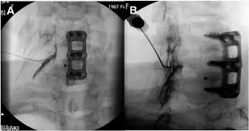
Standard of Care/Best Practice Guidelines
ODG on Transforaminal ESI:
Radiculopathy on PE
Consistent w/ MRI/EMG
Unresponsive to PT; HEP;NSAIDs
No “series of 3”
Max 2 spinal nerves
New for 2016 ODG:
Cervical ESI not recommended???
Say what??

Slide 39
Standard of Care/Best Practice Guidelines
Cervical ESI
“American Academy of Neurology recently concluded insufficient evidence to make any recommendations for use of ESI for cervical radicular pain with certain exceptions.” -ODG
Armon et al. Neurology 2007

Slide 40
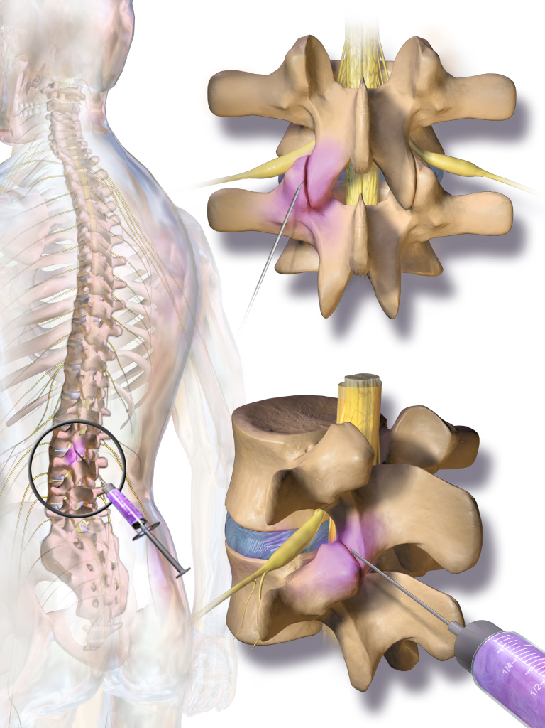
Standard of Care/Best Practice Guidelines
ODG on Facet Joint Injections:
Limited to axial spine pain
N/L sensory exam; neg SLR; etc
No more than 2 joints injected
Volume >0.5cc per joint
No opioids given for sedation
Pain Diary w/activity log (ie RTW)
>70% relief with anesthetic

Slide 41
Standard of Care/Best Practice Guidelines
FCE with validity testing:
Assess work tolerance by giving data to quantify patient effort;
Heart Rate variance >25% increase above resting HR
Grip/Resistance dynamometer graphing
Cog-Wheel Muscle Release
Pain behaviors

Slide 42
If You Want Patients to get better!
Appropriate physician evaluation
Judicious use of Ancillaries
ODG guidelines for Interventional work up; Minimize Overutilization; (? Spine Surgery performing interventional Tx and spine surgery)
.
MMPI/Psych eval
FCE with Validity testing

