Slide 1
Kris Siemionow, MD
Chief of Spine Surgery Assistant Professor of Orthopaedics
and Neurosurgery University of Illinois Chicago, Illinois
Illinois Spine & Scoliosis Center

Slide 2
Definitions
Spondylosis-degeneration of the spine
  It is an ICD-9 diganosis 721.0 (cervical spondylosis without myelopathy)
  ICD-9 diganosis 721.1 (cervical spondylosis with myelopathy)
Myelopathy-
Myelo- spinal cord
Pathy- disease
Radiculopathy
  Radix- root
  Pathy- disease
Somatic Pain
  Soma- body
Radiculitis
  itis- inflammation
Illinois Spine & Scoliosis Center

Slide 3
History
Illinois Spine & Scoliosis Center
56 year old female lifting injury presenting with right shoulder pain and tingling in right forearm and hand
Diagnosed with rotator cuff
Undergoes 6 months of conservative management while on sedentary duty
Her hand symptoms improve with the conservative management

Slide 4
History
Illinois Spine & Scoliosis Center
Shoulder pain persists
Then undergoes shoulder surgery for rotator cuff tear
1 week after shoulder surgery she develops radicular symptoms with some mild neck pain
Undergoes 3 months of therapy with little improvement in shoulder and UE symptoms

Slide 5
Has FCE, sedentary duty, placed at MMI
Sees me
Illinois Spine & Scoliosis Center

Slide 6
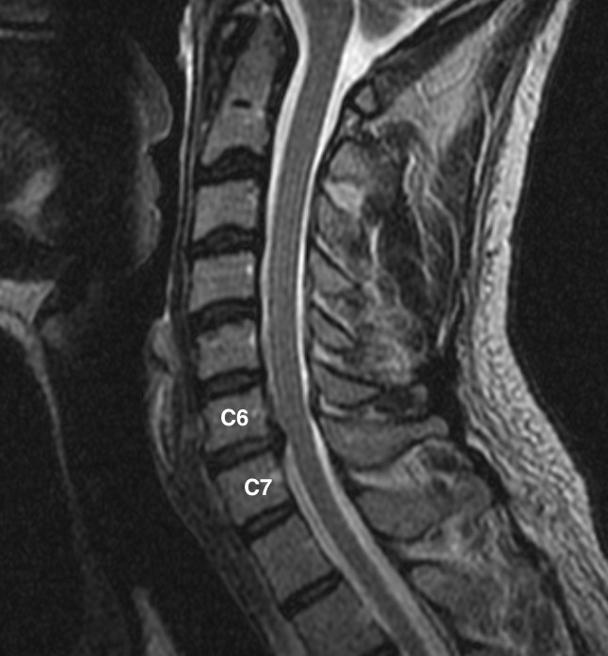
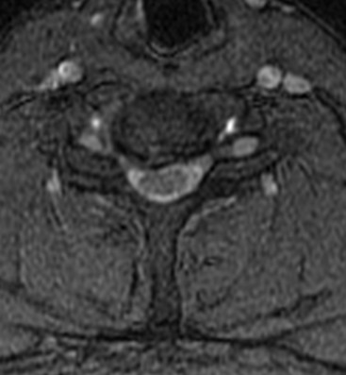
MRI
Illinois Spine & Scoliosis Center

Slide 7
Next steps in management?
C67 nerve block
Illinois Spine & Scoliosis Center

Slide 8
IME- not related, treatment
denied
Illinois Spine & Scoliosis Center

Slide 9
Can a disc herniation cause shoulder pain?
Illinois Spine & Scoliosis Center

Slide 10
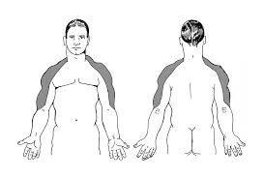
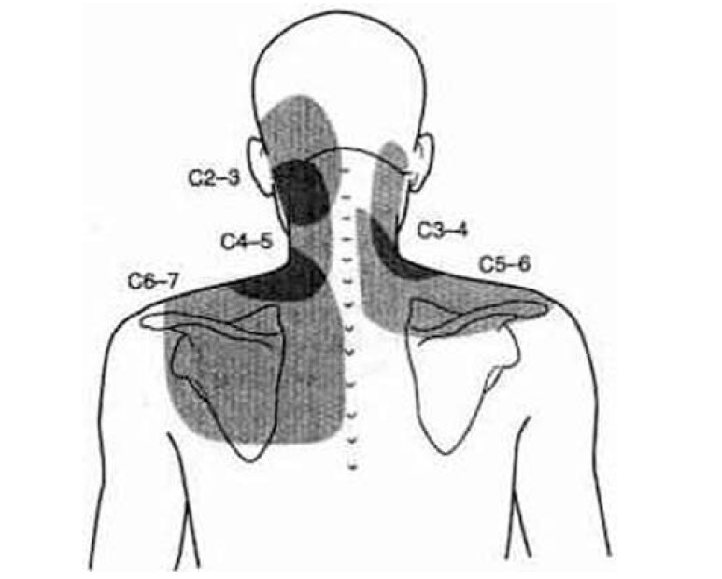
Referred pain from herniated disc
C5 and C6 dermatomes
Illinois Spine & Scoliosis Center

Slide 11
Can shoulder surgery cause radicular pain???
Illinois Spine & Scoliosis Center

Slide 12
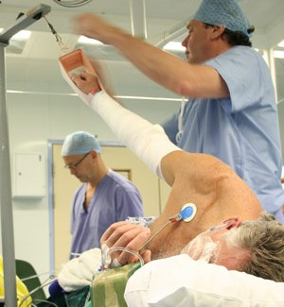
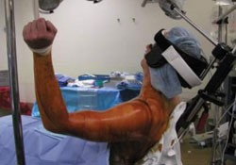
YES→→ Positioning
Illinois Spine & Scoliosis Center

Slide 13
Low Back Pain, Lumbar Strain and Lumbar Radiculopathy
Illinois Spine & Scoliosis Center

Slide 14
History
Illinois Spine & Scoliosis Center
33 year old male who was on a delivery route
Felt a LBP at the end of the day the became severe and started to spread into his buttock
Placed oﬀ work, underwent therapy
Did not improve
Saw spine specialist
Epidural was ordered
I was the IME doctor
Appointments: (877) 694-­‐7722

Slide 15
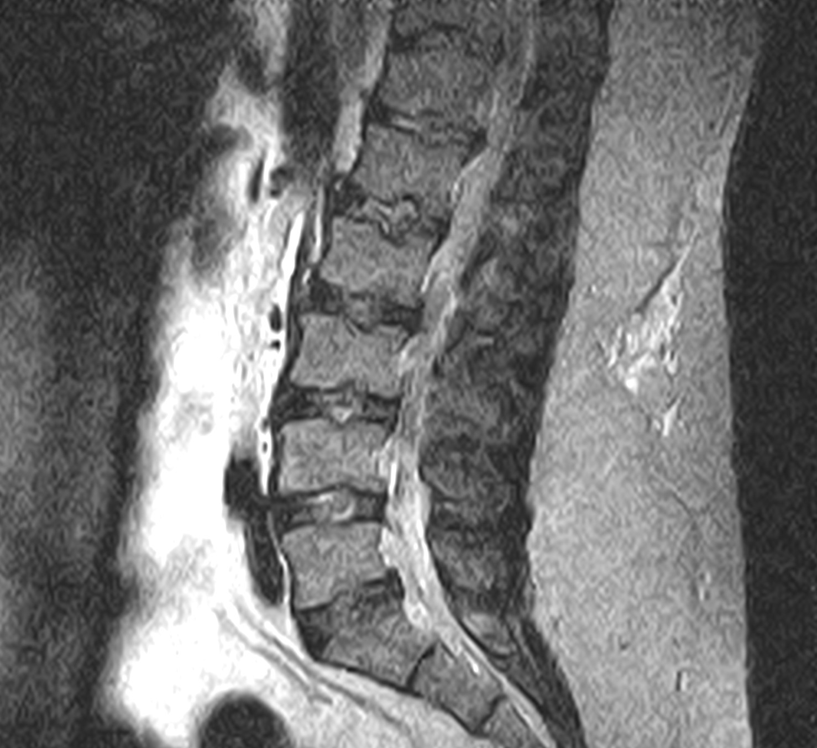
Illinois Spine & Scoliosis Center

Slide 16
Imaging findings
L5-S1 disc herniation
TL Scheuermann’s disease
Illinois Spine & Scoliosis Center

Slide 17
My Diagnosis
Lumbar strain + temporary exacerbation of pre-existing degenerative disc disease
MMI at 3 months
Symptoms after MMI are part of pre-injury baseline
Work status Medium to Heavy Duty
Illinois Spine & Scoliosis Center

Slide 18
Why?
Illinois Spine & Scoliosis Center
Unable to specify pain generator
No clear pain pattern attributable to disc herniation
No improvement with injection
Based on MRI findings it would be unlikely that his changes are asymptomatic
Obesity

Slide 19
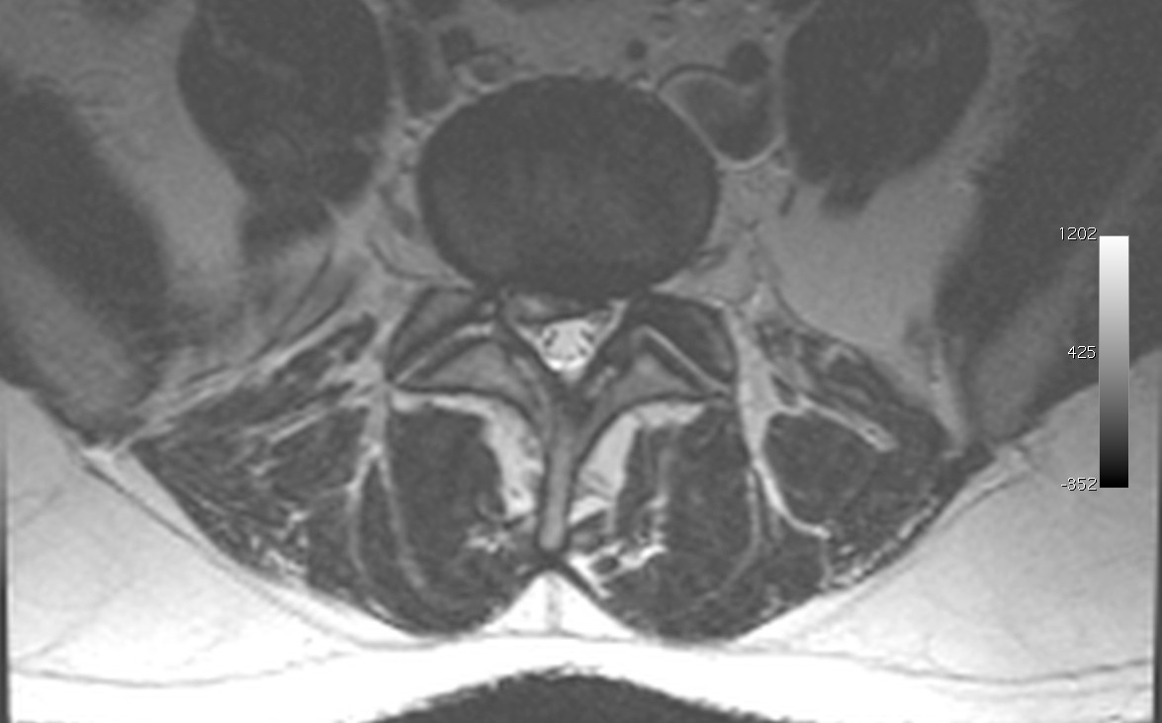



Disc Herniation
Illinois Spine & Scoliosis Center

Slide 20
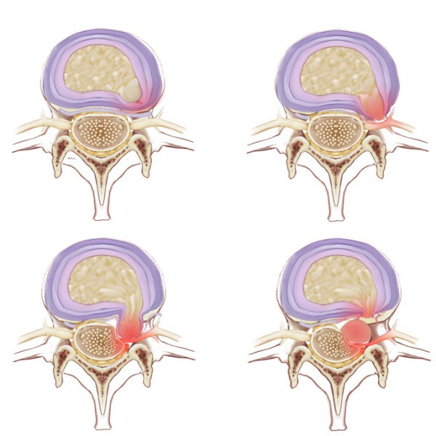
Disc Herniation
Disc Bulge Disc Protrusion
Ext
qu
Illinois Spine & Scoliosis Center
Appointments: (877) 694-­‐7722

Slide 21

Outcomes with No Intervention
Illinois Spine & Scoliosis Center
Hakelius A. Prognosis in sciatica : a clinical follow-up of surgical and non surgical treatment. Acta Orthop Scand 1970 ; Suppl
1970 : 129.

Slide 22
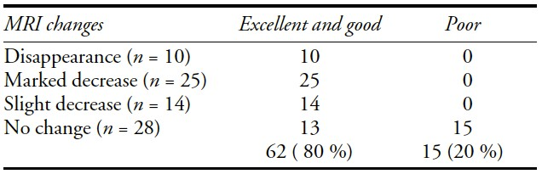
Correlation between change in herniated disc size on MRI and
symptoms
Illinois Spine & Scoliosis Center
Komori H, Shinomiya K, Nakai O, Vamaura I, Takeda S,
Fuyura K. The natural history of herniated nucleus pulposus with radiculopathy. Spine 1996 ; 21 : 225-9.

Slide 23
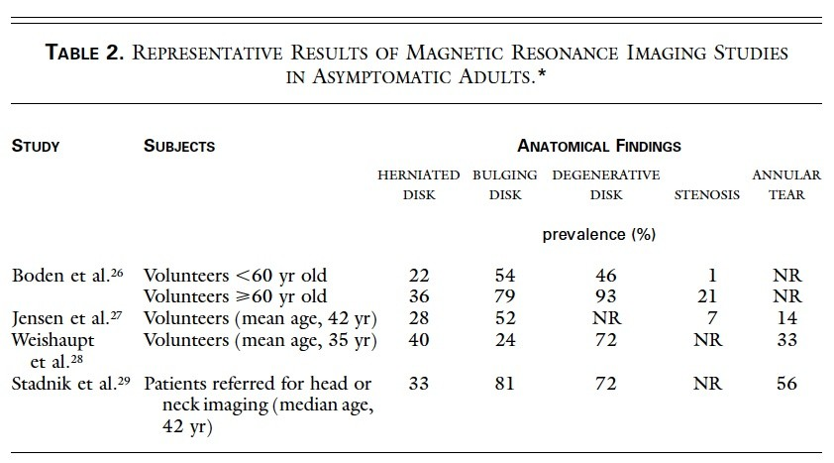
Illinois Spine & Scoliosis Center
Deyo RA. N Engl J Med, Vol. 344, No. 5. February 1, 2001

Slide 24
Next reasonable step in management?
Illinois Spine & Scoliosis Center

Slide 25
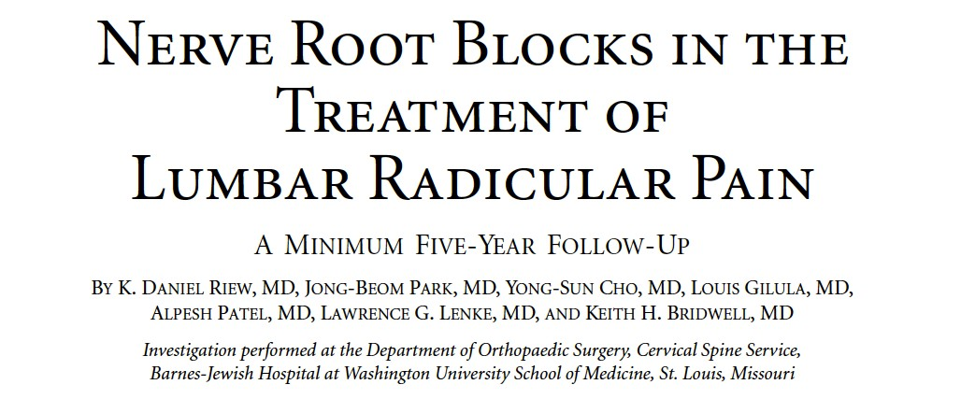
Illinois Spine & Scoliosis Center
Conservative Management
Algorithm
1. Pain control-­‐ mild opiate, muscle relaxant, ?medrol dose pak
2. Therapy-­‐ ROM, traction, manipulation
3. Selective nerve root block
Patients with radicular pain who avoid an operation for at least one year after injection will continue to avoid operative intervention for a minimum of five years

Slide 26
Surgical Indications
Progressive neurologic deﬁcit
Failure of conservative management
Intractable pain
Illinois Spine & Scoliosis Center
Appointments: (877) 694-­‐7722

Slide 27
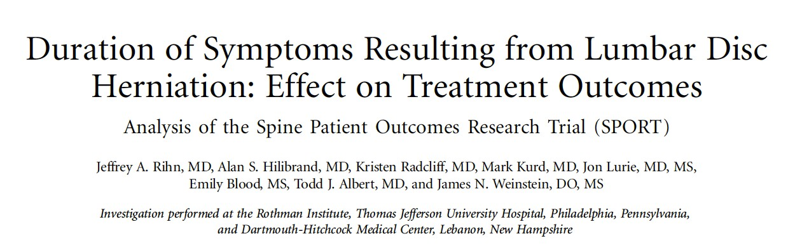
Signiﬁcance of Treatment Delay
Illinois Spine & Scoliosis Center
Patients who are symptomatic for more then 6 month do significantly worse
Appointments: (877) 694-­‐7722

Slide 28
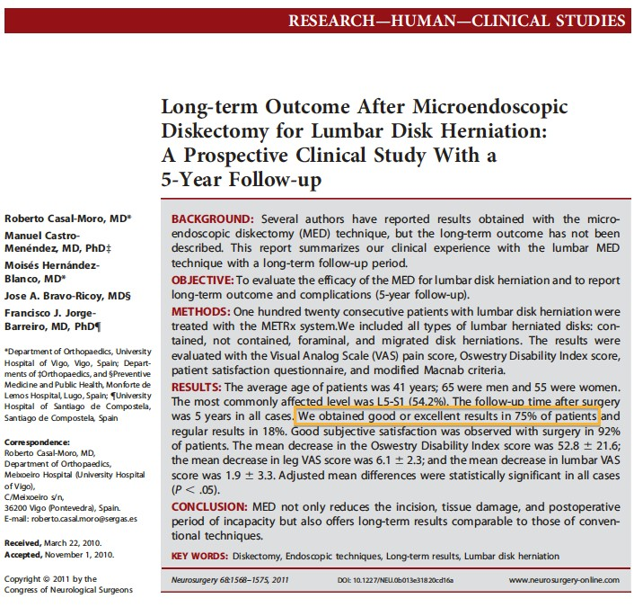
llinois Spine & Scoliosis Center
I

Slide 29
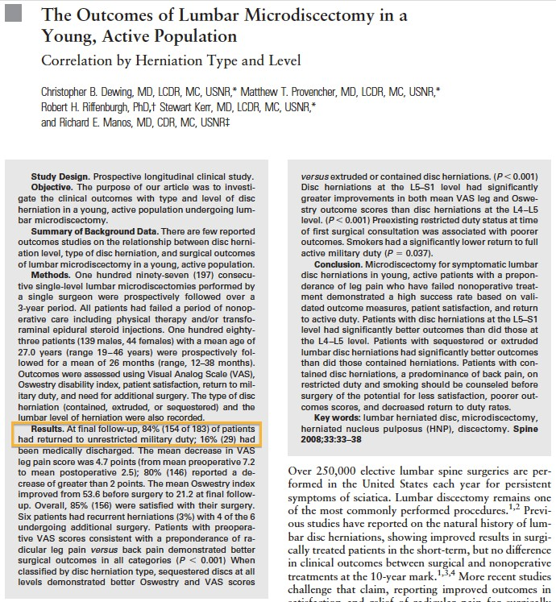
Illinois Spine & Scoliosis Center

Slide 30
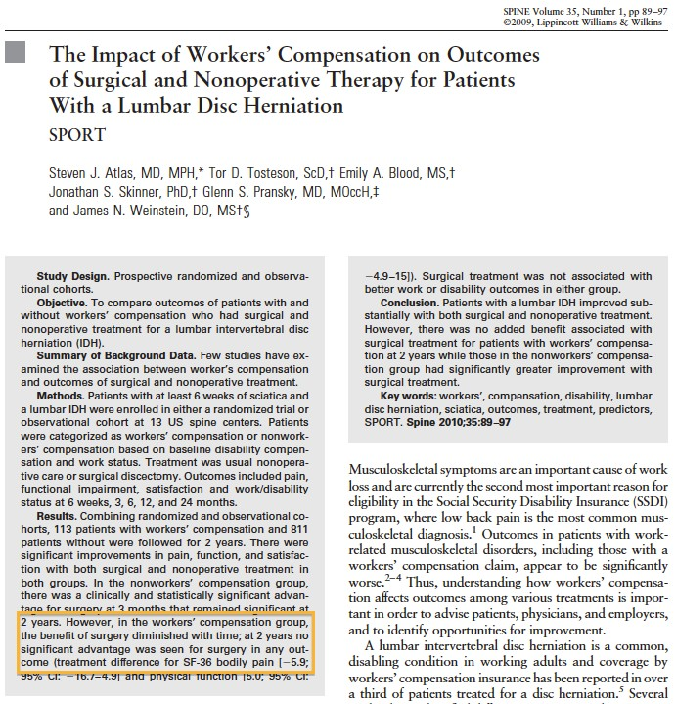
Illinois Spine & Scoliosis Center

Slide 31
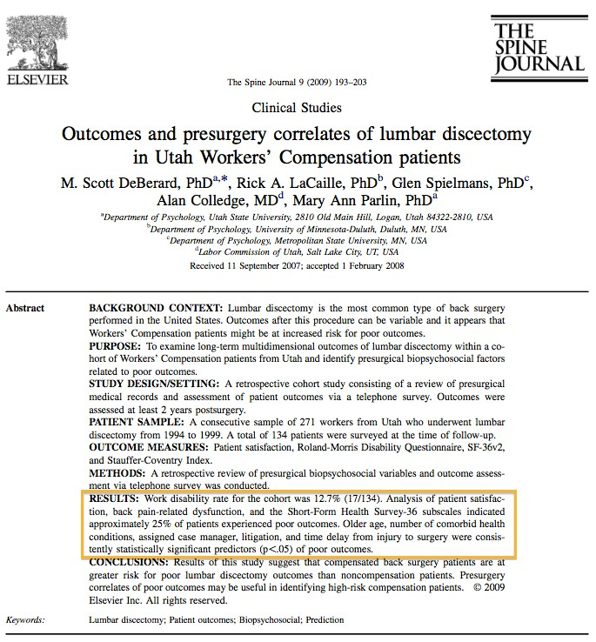
Illinois Spine & Scoliosis Center

Slide 32
Illinois Spine & Scoliosis Center

Slide 33
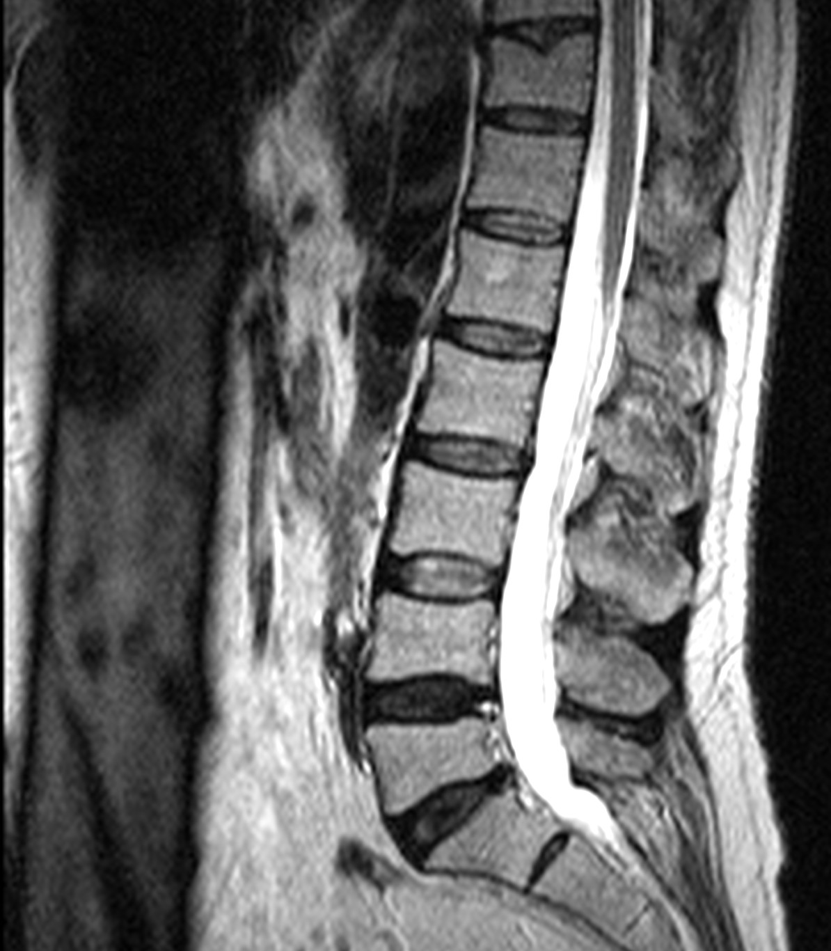
58 y/o laborer, 100% LBP, failed conservative management
Illinois Spine & Scoliosis Center

Slide 34
What to do when conservative management
fails???
Illinois Spine & Scoliosis Center

Slide 35
Need a diagnosis
Illinois Spine & Scoliosis Center

Slide 36
Since changes on MRI do not correlate with symptoms, how do we diagnose the source of the back pain???
Illinois Spine & Scoliosis Center

Slide 37
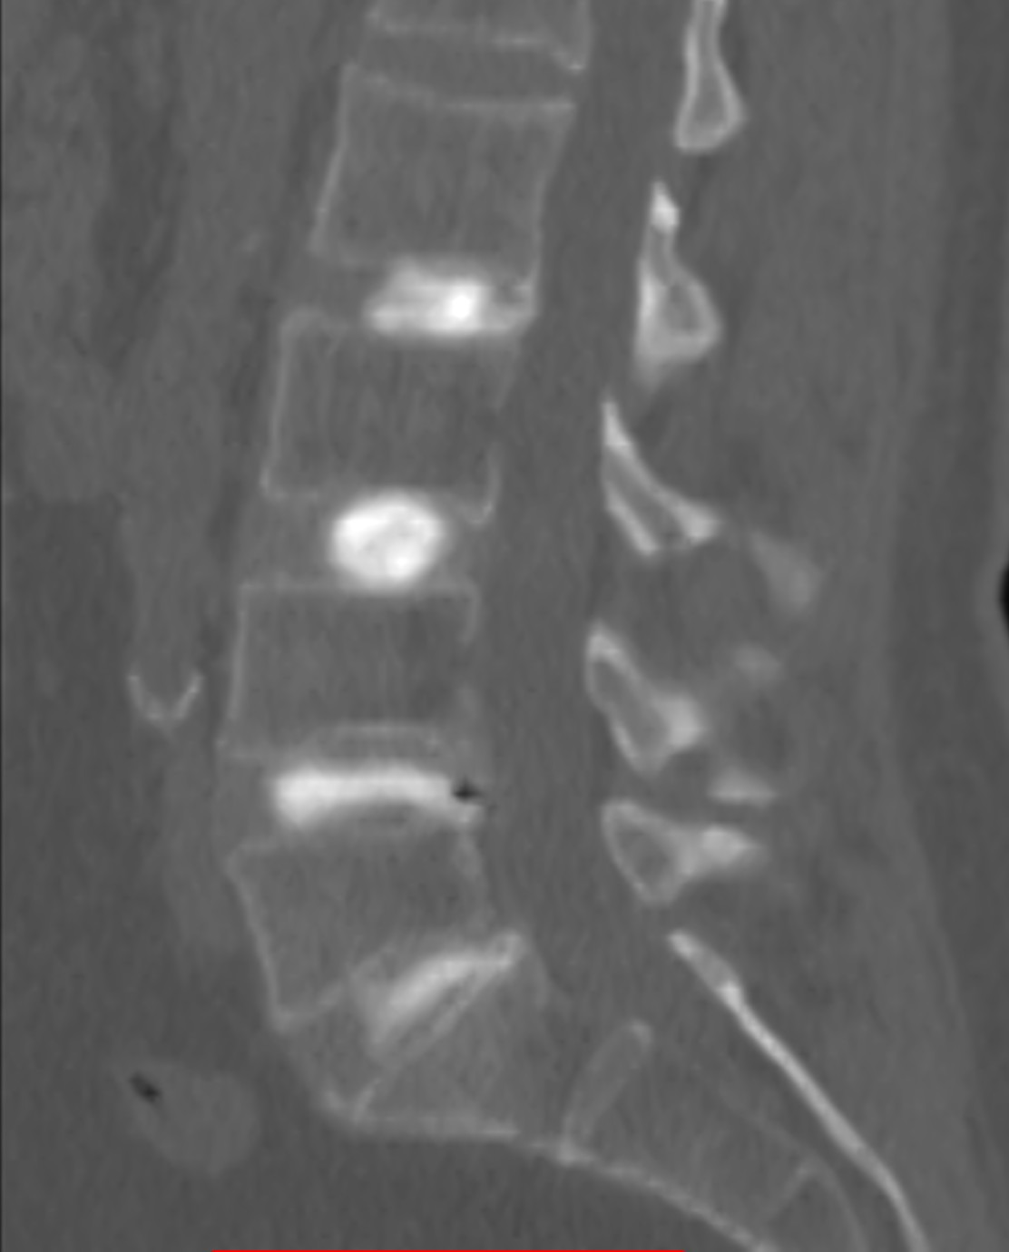
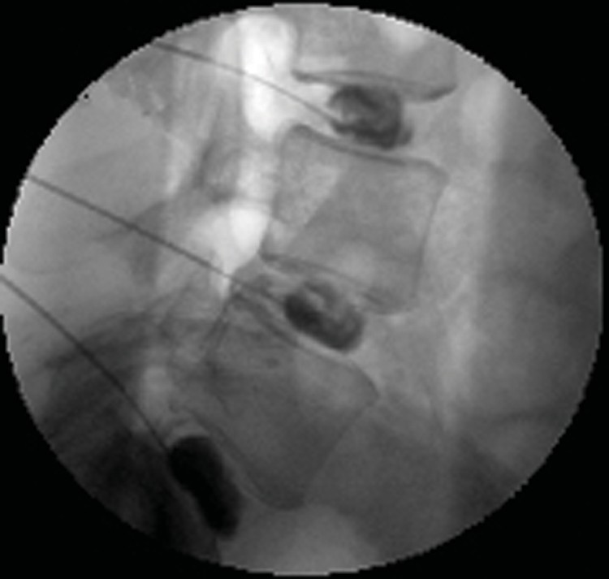
Discogram
Illinois Spine & Scoliosis Center

Slide 38






Whats a discogram?
Illinois Spine & Scoliosis Center

Slide 39
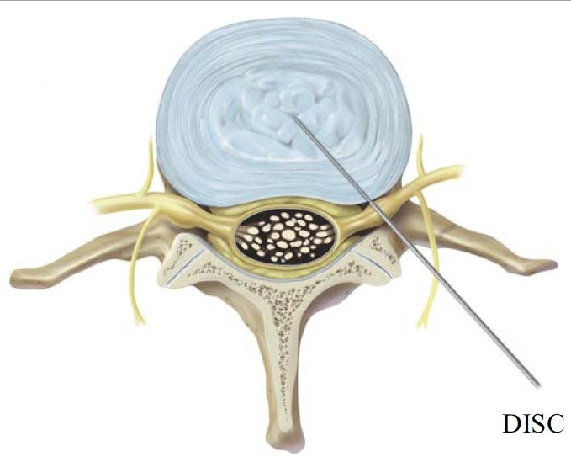
Discography
Invasive study
Disc injected with contrast
Pressure is measured
Pattern of contrast is observed
Amount of pain provoked is recorded
Illinois Spine & Scoliosis Center

Slide 40
Are there any risks to a discogram?
Infection <1%
Nerve injury <1%
Illinois Spine & Scoliosis Center

Slide 41
OUTCOMES
Illinois Spine & Scoliosis Center
Lumbar discography in asymptomatic volunteers-­‐ Positive pain response and pain-­‐related behavior with discography were found in 10% of the healthy subjects, in 40% of patients with neck pain, and in 83% of the somatization disorder (Carragee EJ SPINE 2000;25:1373)
50% of patients with no LBP but with disc degeneration/annular tear on MRI had a positive discogram (Carragee EJ SPINE 1999;24:2542)

Slide 42
How do we study disc degeneration?
Illinois Spine & Scoliosis Center

Slide 43
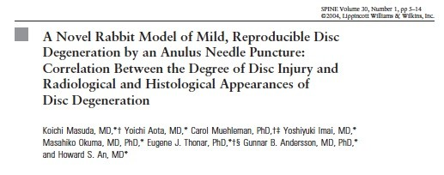
Illinois Spine & Scoliosis Center
“…..In each rabbit, each of the 4 exposed discs was punctured by 1 of 3 sizes of needles (16G, 18G, and 21G)
…“…...”.In the stabbed discs, significant disc space narrowing was observed as early as 2 weeks after stabbing…….”

Slide 44
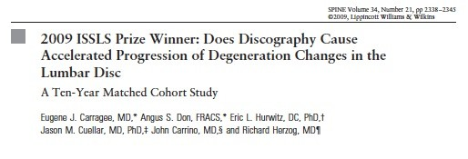
OUTCOMES
Illinois Spine & Scoliosis Center

Slide 45
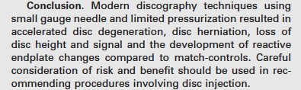
OUTCOMES OF DISCOGRAPHY
Illinois Spine & Scoliosis Center

Slide 46
Thank you
www.siemionow.com
Illinois Spine & Scoliosis Center

